Slide 1

Applications of Python Programming for Catalyst Characterization
By: Jamie DeCoster

Slide 2

Introduction: Research Topic
CO
CO₂
Automobiles and other combustion sources release carbon monoxide [1,2]
Oxidizing CO into CO₂ reduces toxicity [1,2]
Platinum group metals are currently used for CO oxidation, but these catalysts are expensive, difficult to obtain and have low activity at low temperatures [3]
Cerium oxide (CeO₂) is a promising catalyst as it can easily switch between 4⁺ and 3⁺ oxidation states forming oxygen vacancies [4,5,6]
Oxygen vacancies and defect sites are related to catalytic performance as they can act as active sites for CO oxidation
Research examining influence of pretreatment temperature and condition (reducing/oxidizing/inert) on ceria to evaluate the impact on the physiochemical properties and catalytic activity
O
O
O
O
CeO₂
O
O
O
CeO_{2-x}
Ce³⁺
Ce³⁺

Slide 3

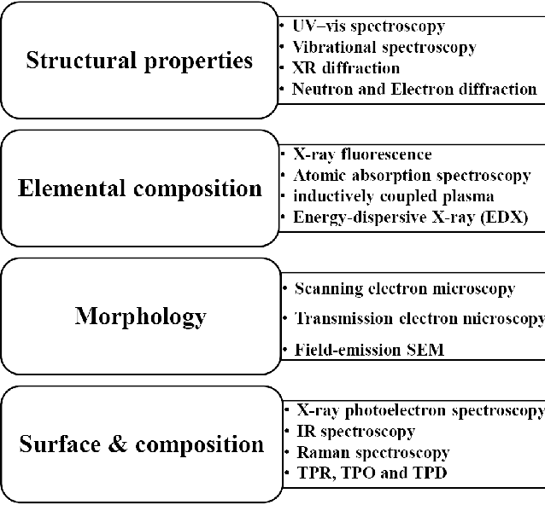

The Problem
Characterization of catalysts uses many different techniques
XRD
BET
These techniques require various numerical methods to analyze the results
With multiple samples, analysis could take a long time when performed by hand
Many applications capable of the calculations such as OriginLab require subscriptions
[7]
[8]

Slide 4
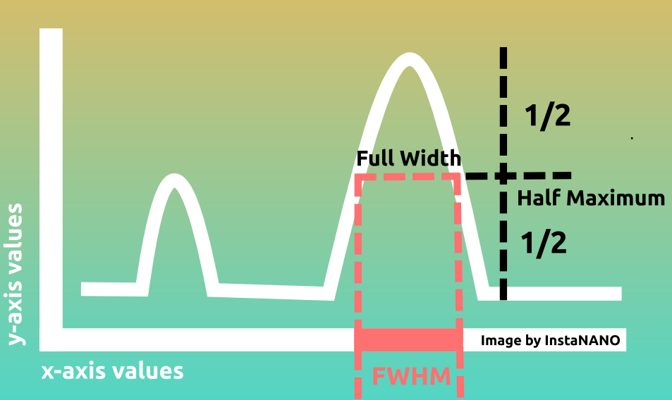

Background: XRD
[9]
Characterization technique used for determining phase composition, crystal structure, crystallite size, orientation of powder, etc. [10]
Crystallite size requires the use of the Scherrer Equation
Requires determination of
Maximum value
2θ value at which the maximum occurs
Determination of the width of half the maximum
Goal: Plot the XRD spectra and determine the crystallite size
Scherrer Equation [9]
$$D=\frac{K∗λ}{β∗cos⁡(θ)}$$
K: Shape Factor λ: X-ray Wavelength
β: FWHM θ: Bragg Angle

Slide 5
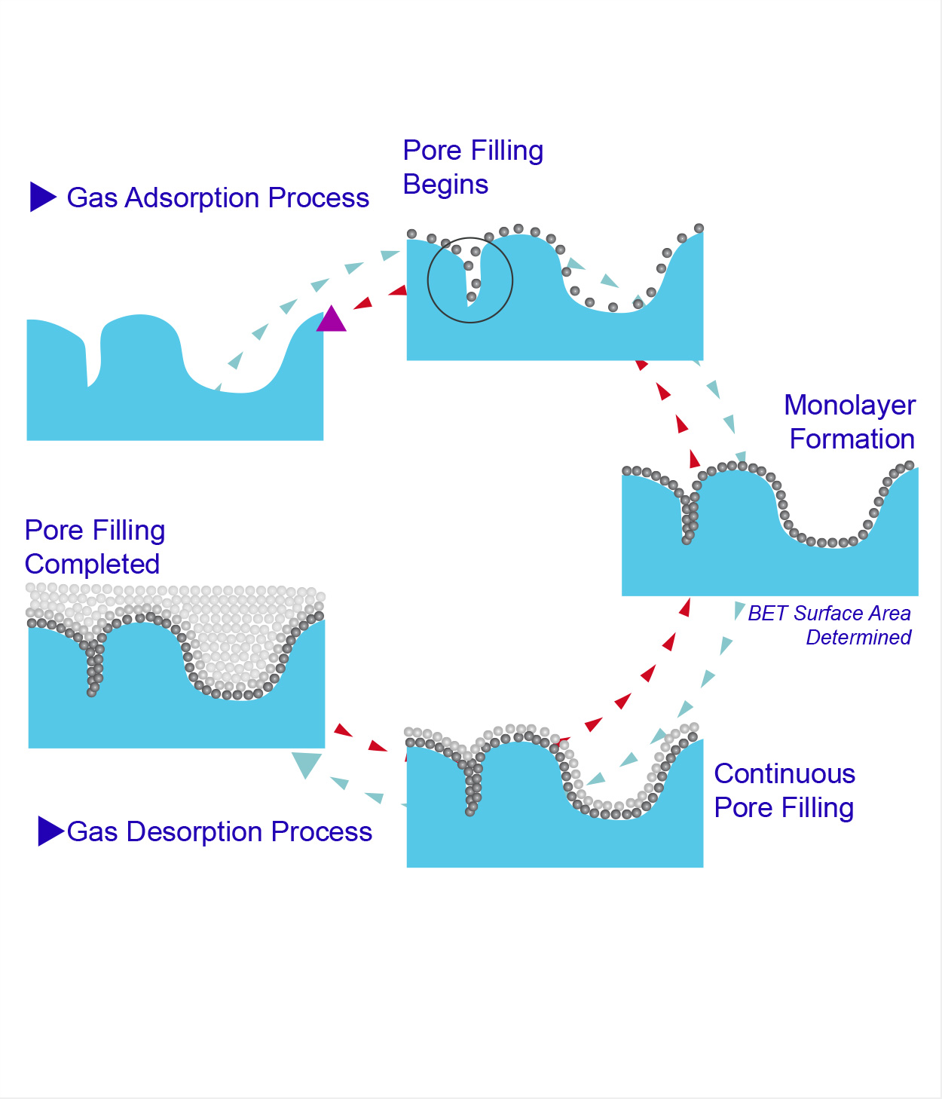







Background: Brunauer-Emmett-Teller (BET) Analysis
BET equation
$$v=\frac{c∗v_{m}∗P/P_{0}}{\left(1−P/P_{0}\right)[1+\left(c−1\right)∗P/P_{0}]}$$
BET equation linearized
Characterization technique used for determining the specific surface area (SSA), and pore size distributions of catalysts [12]
To determine the SSA, the data must be examined when only a monolayer has formed. (0.025 < P/P₀ < 0.30) [12]
Goal: Create a program that can plot adsorption isotherms and calculate the SSA
$\frac{P/P_{0}}{v∗(1−P/P_{0})}=\frac{1}{v_{m}∗c}+\frac{\left(c−1\right)∗P/P_{0}}{v_{m}∗c}$
Slope= $\frac{\left(c−1\right)}{v_{m}∗c}$ y-intercept= $\frac{1}{v_{m}∗c}$
$$v_{m}=\frac{1}{slope+intercept}$$
$v_{m}:$ Monolayer Capacity
$$SSA=\frac{v_{m}∗σ_{0}∗N_{avogadros}}{0.0224 m^{3}/mol}$$
11
$σ_{0}$: Cross-sectional area of N₂ (16.2 Å²)

Slide 6
Background: Brunauer-Emmett-Teller (BET) Analysis
BET equation
$$v=\frac{c∗v_{m}∗P/P_{0}}{\left(1−P/P_{0}\right)[1+\left(c−1\right)∗P/P_{0}]}$$
BET equation linearized
Characterization technique used for determining the specific surface area (SSA), and pore size distributions of catalysts
To determine the SSA, the data must be examined when only a monolayer has formed. (0.025 < P/P₀ < 0.30)
$\frac{P/P_{0}}{v∗(1−P/P_{0})}=\frac{1}{v_{m}∗c}+\frac{\left(c−1\right)∗P/P_{0}}{v_{m}∗c}$
Slope= $\frac{\left(c−1\right)}{v_{m}∗c}$ y-intercept= $\frac{1}{v_{m}∗c}$
$$v_{m}=\frac{1}{slope+intercept}$$
$v_{m}:$ Monolayer Capacity
$$SSA=\frac{v_{m}∗σ_{0}∗N_{avogadros}}{0.0224 m^{3}/mol}$$
$σ_{0}$: Cross-sectional area of N₂ (16.2 Å²)

Slide 7

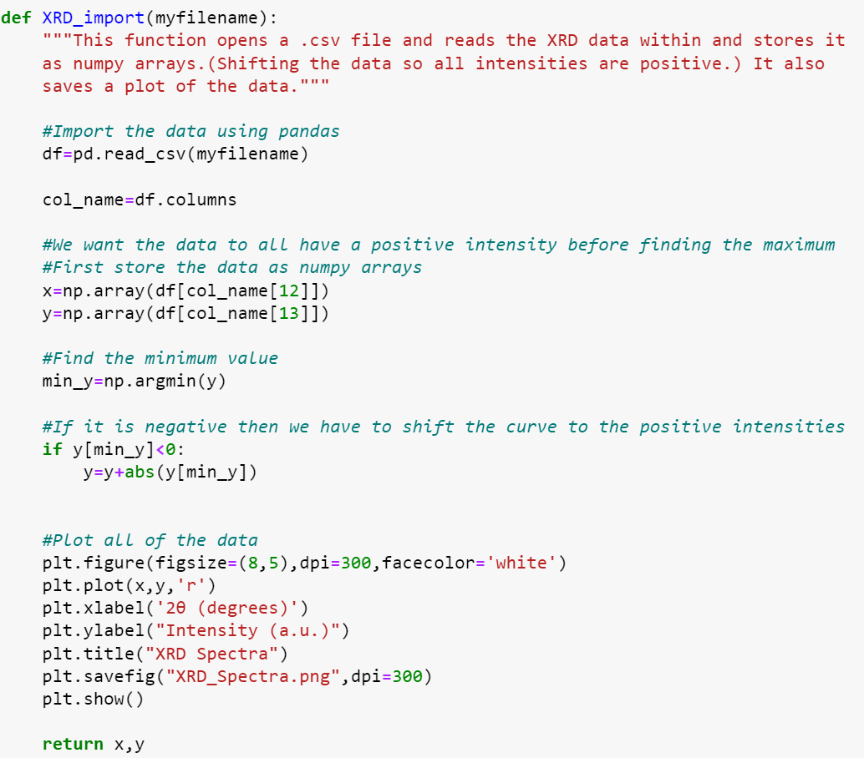
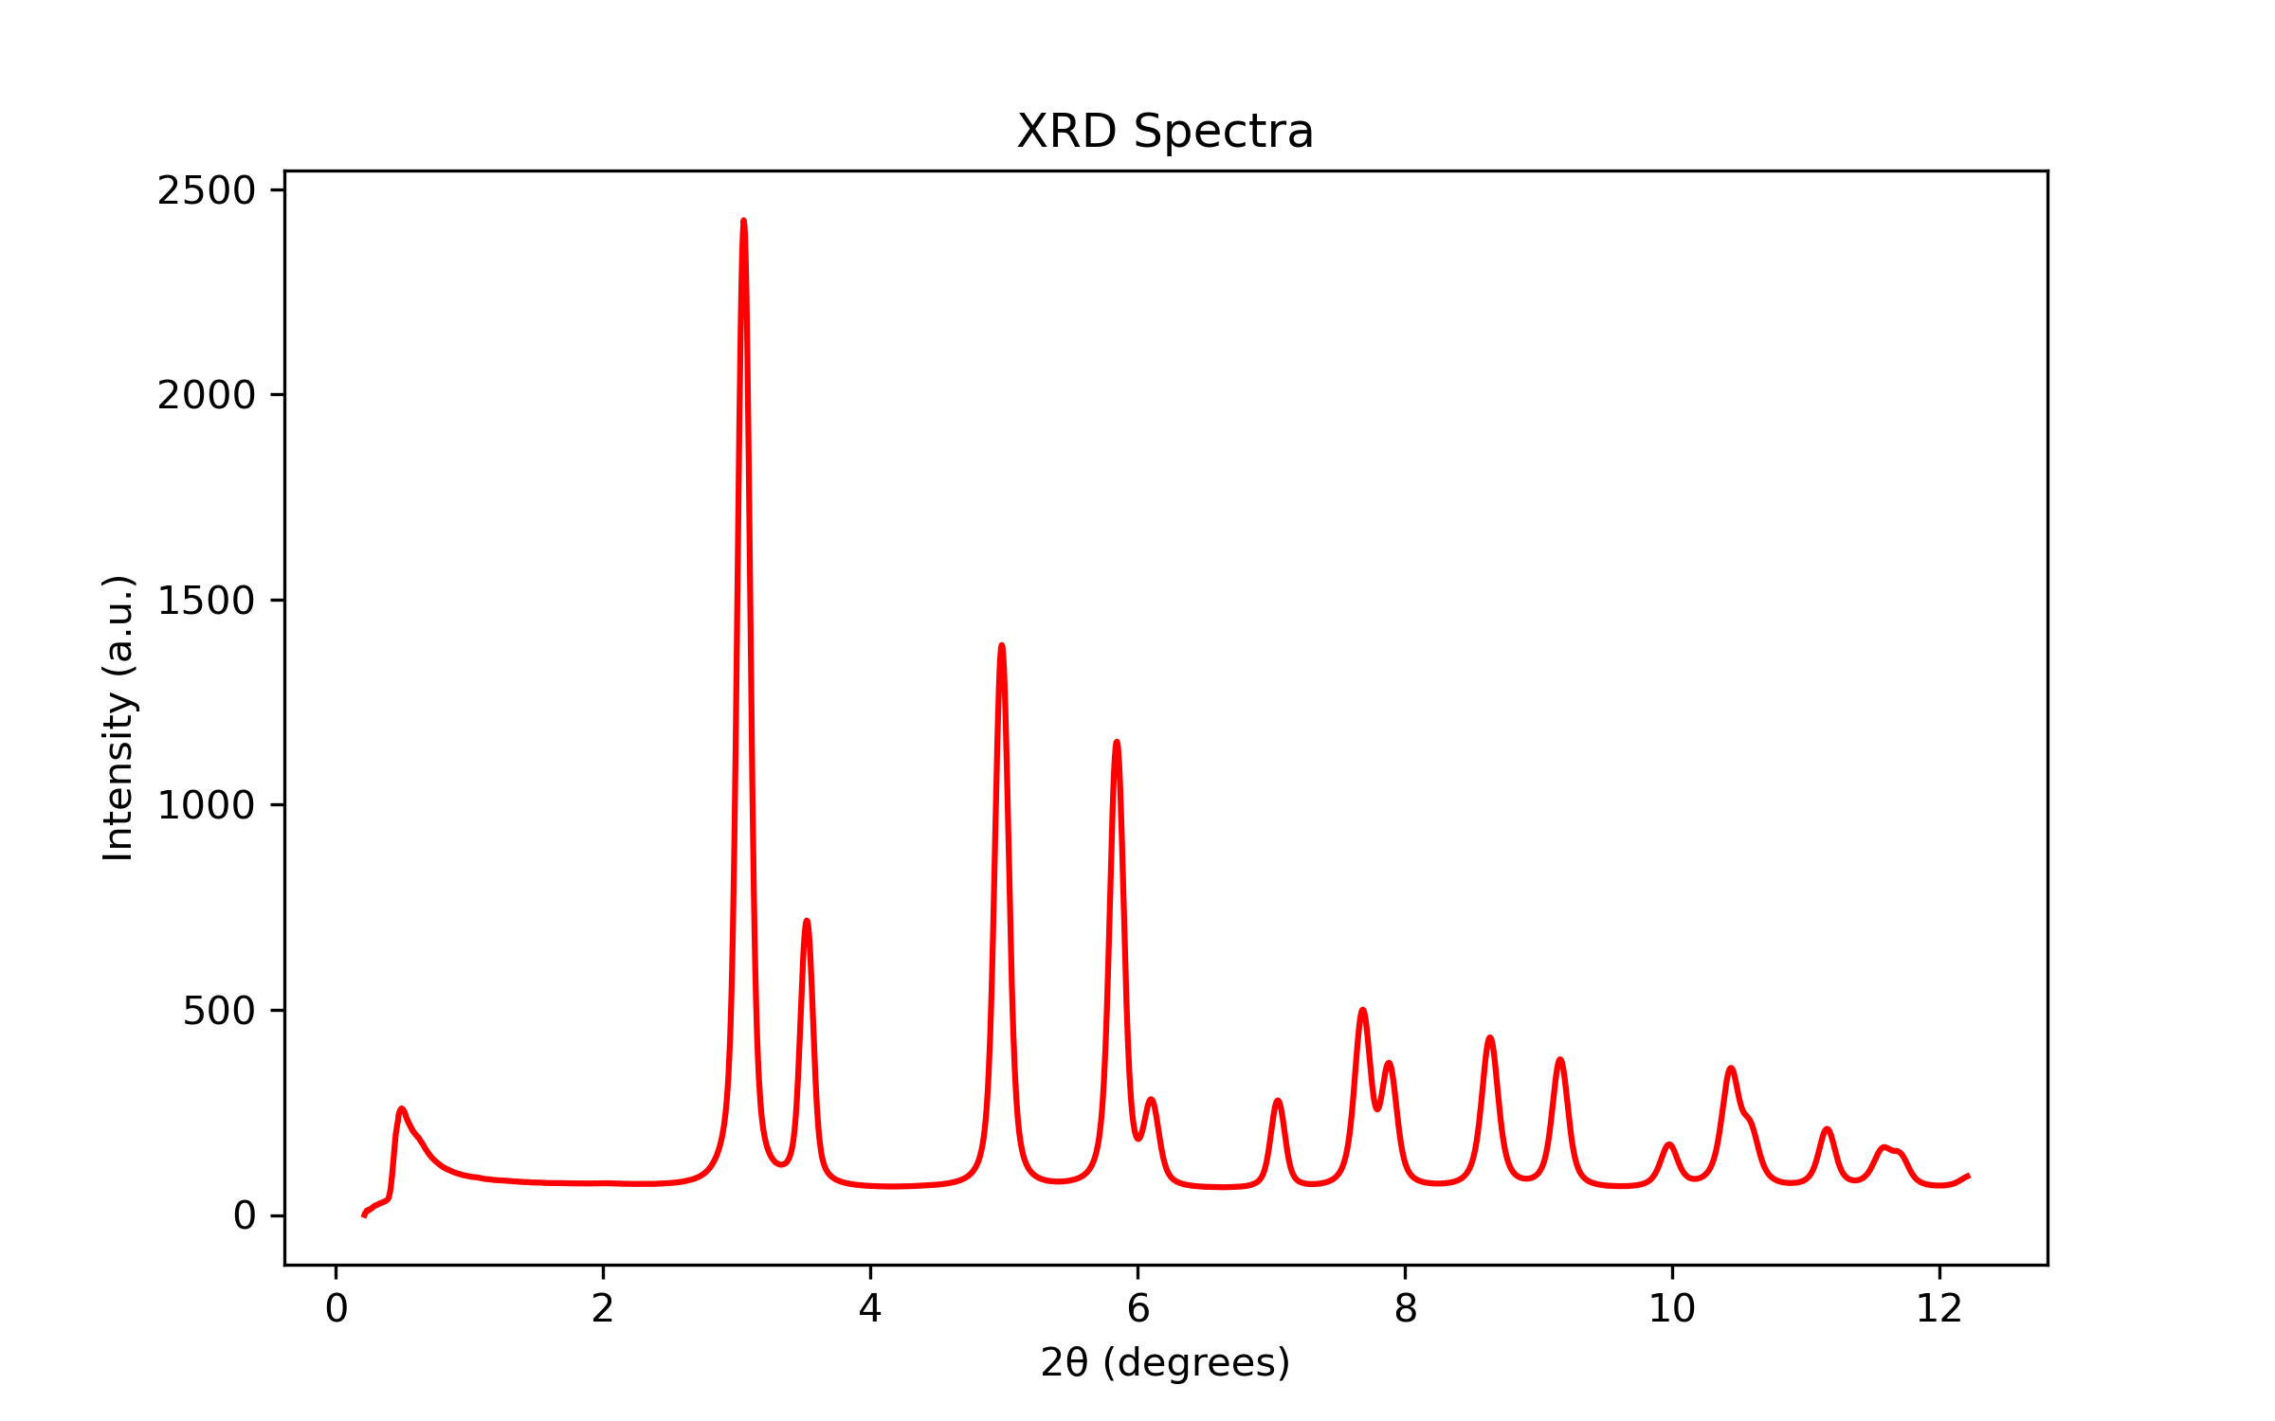
Approach: XRD
Function 1: XRD_import
1 input: data file name
Uses pandas to import the data and store it in numpy arrays
Based on the minimum, shifts all the data to positive intensity values if necessary
Plots the XRD results

Slide 8
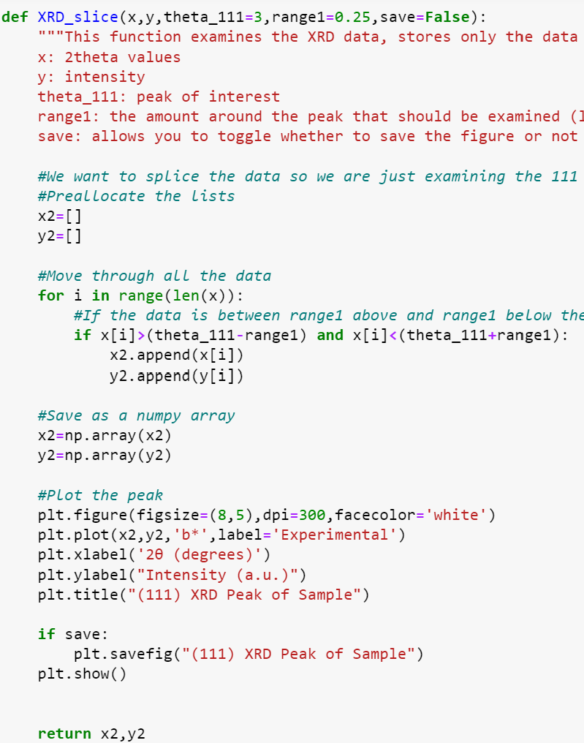
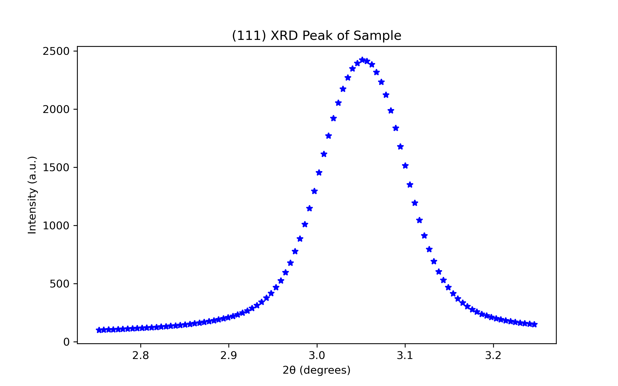
Approach: XRD
Function 2: XRD_Slice
5 inputs: 2θ (x) and intensity data (y), value of the peak of interest (optional), spread of peak of interest (optional), and a variable to toggle saving the figure
Iterates through the data and saves the data within the given range into new x and y arrays
Displays the plot so user can determine if the peak was properly sliced
Option to save the figure

Slide 9
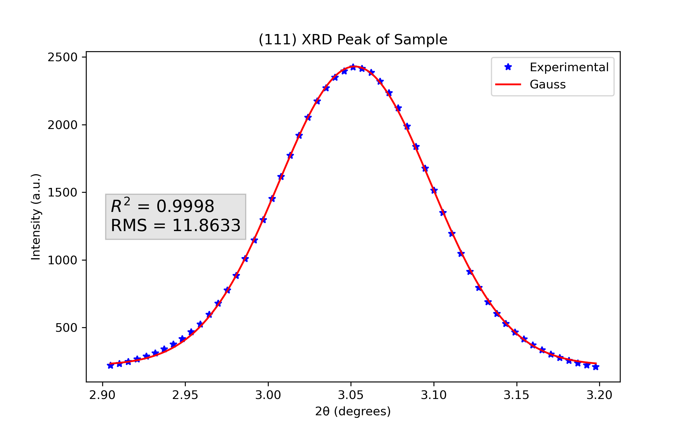
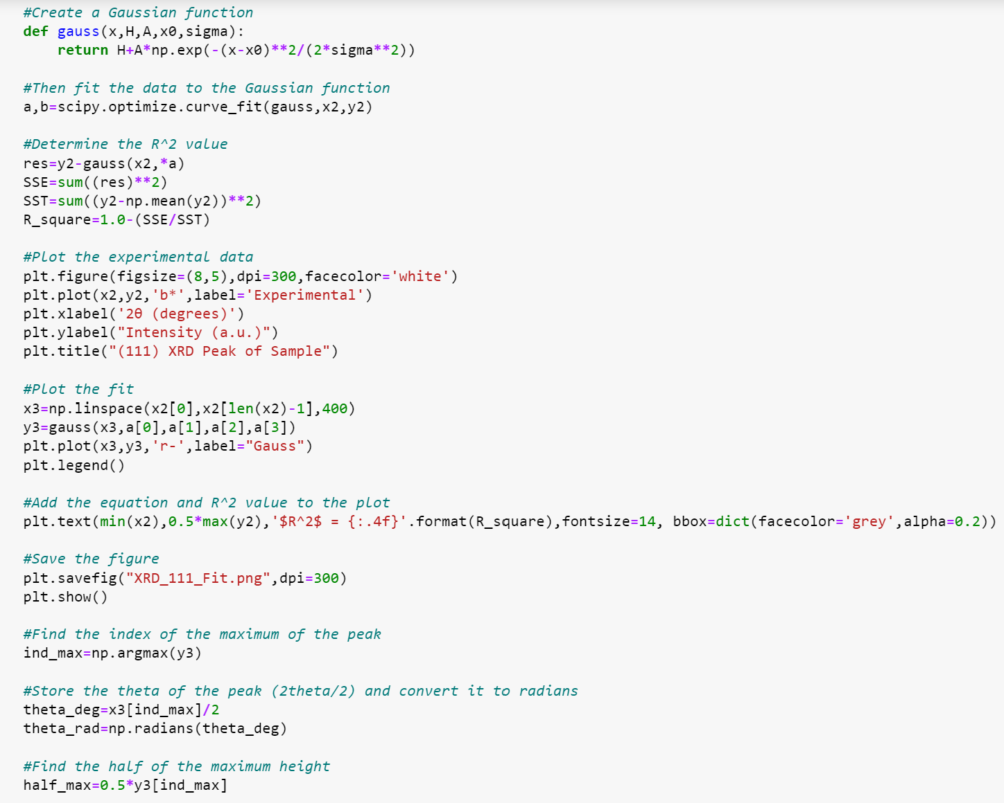
Approach: XRD
Function 3: XRD_FWHM
2 inputs: 2θ data of the specific peak, and the corresponding intensity data
Uses curve fitting of a Gaussian function to the data and calculates arrays of data using the fitted-function
Finds the index of the maximum intensity value and stores the theta location and half max.
y_{half-max}
2θ_{max}

Slide 10
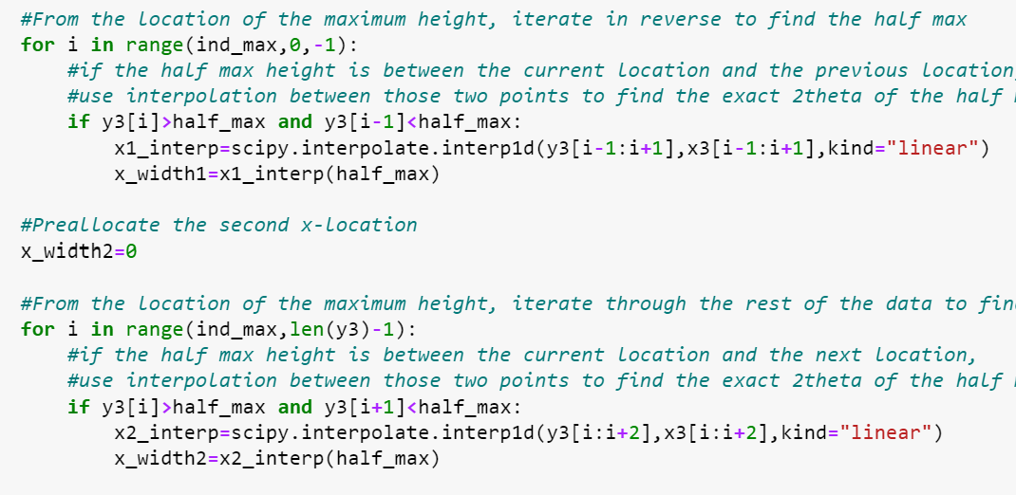
Approach: XRD
Function 3: XRD_FWHM
Iterates through the data from the maximum in both the +x and –x directions to find two data points that surround half of the maximum.
Uses interpolation to get the actual 2θ location of the half max
Subtracts them to get the width at half the maximum (FWHM)
2 outputs: FWHM and 2θ value of the maximum

Slide 11
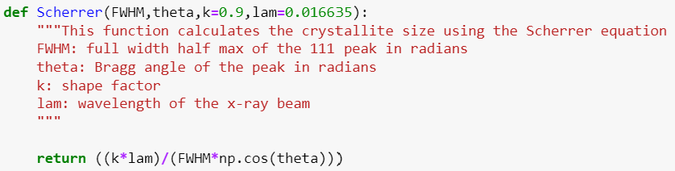
Approach: XRD
Function 4: Scherrer
4 inputs: FWHM, theta value of the maximum, shape factor (k) (optional) and lamda (optional)
Plugs the 4 inputs into the Scherrer equation and returns the crystallite size
Scherrer Equation
$$D=\frac{K∗λ}{β∗cos⁡(θ)}$$

Slide 12
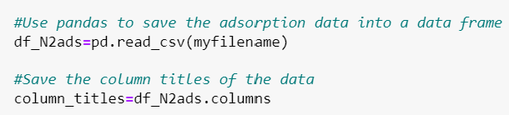
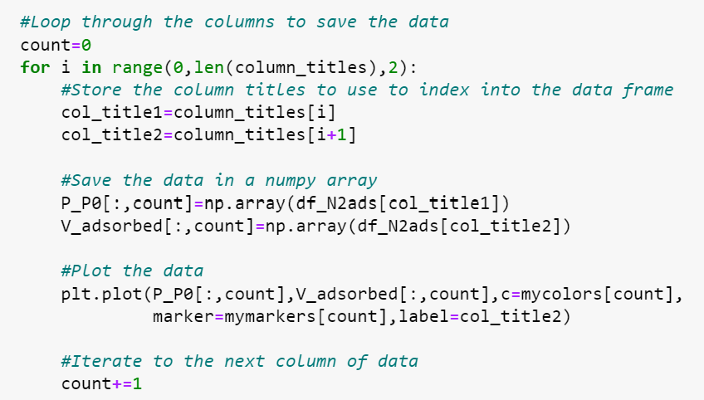
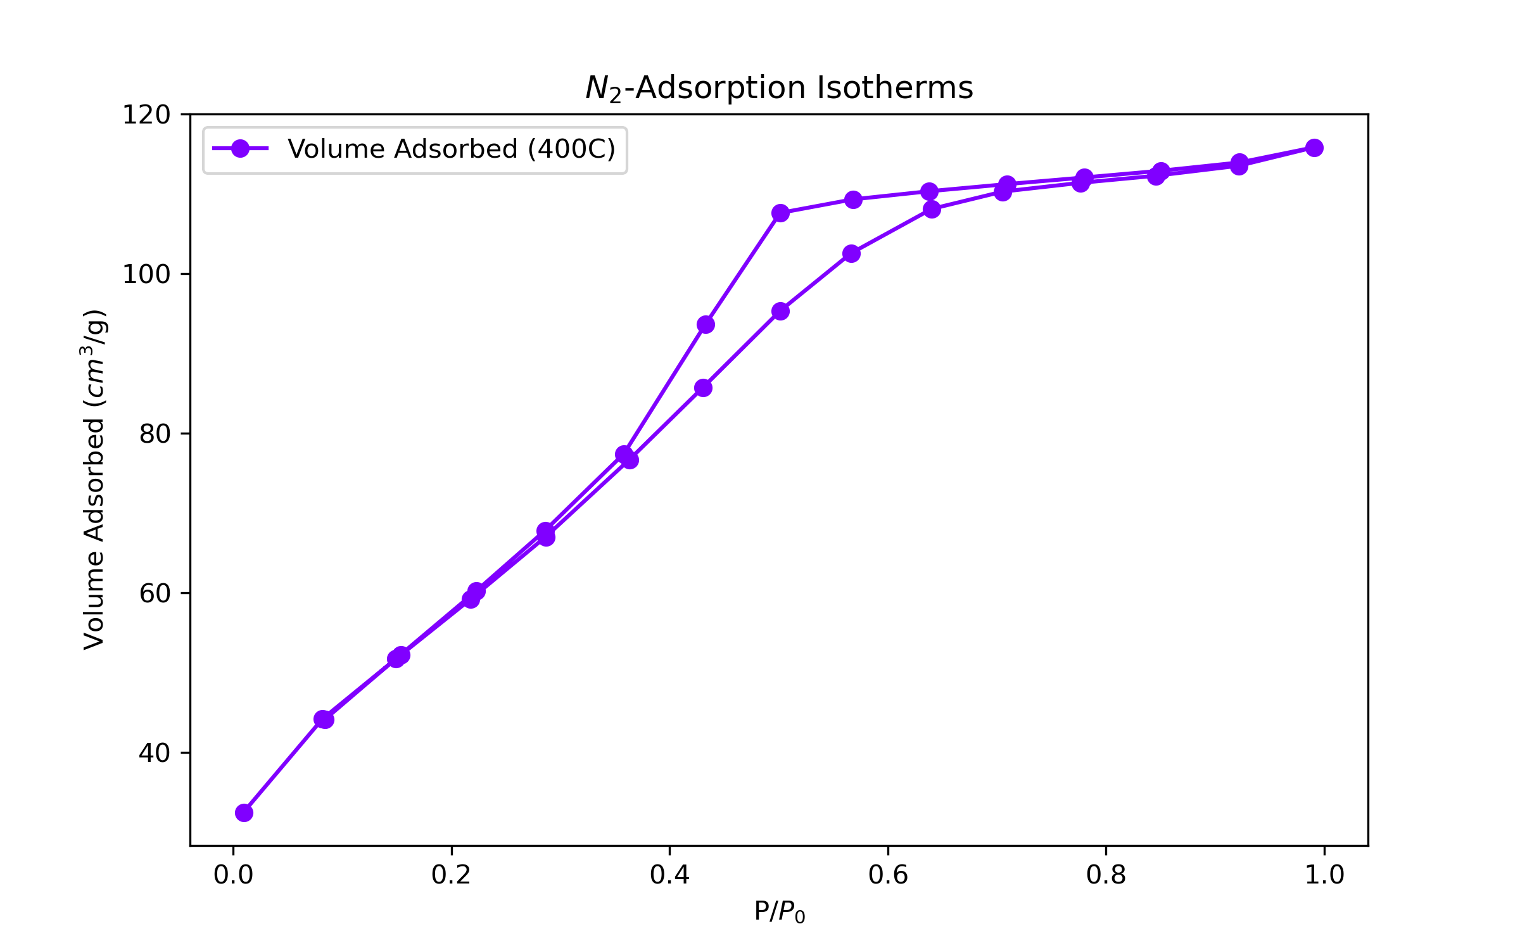
Approach: BET
Function 1: N2ads
1 input: Filename
Uses Pandas to read the data within the file (for any number of samples)
Store the column titles
Iterate through the column titles to index into the data and store it as numpy arrays for any number of samples
Plots the N₂-Adsorption Isotherms
Returns P/P0 and V_{adsorbed}

Slide 13
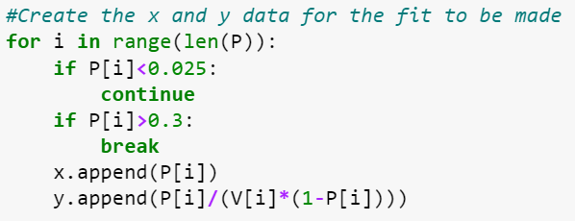
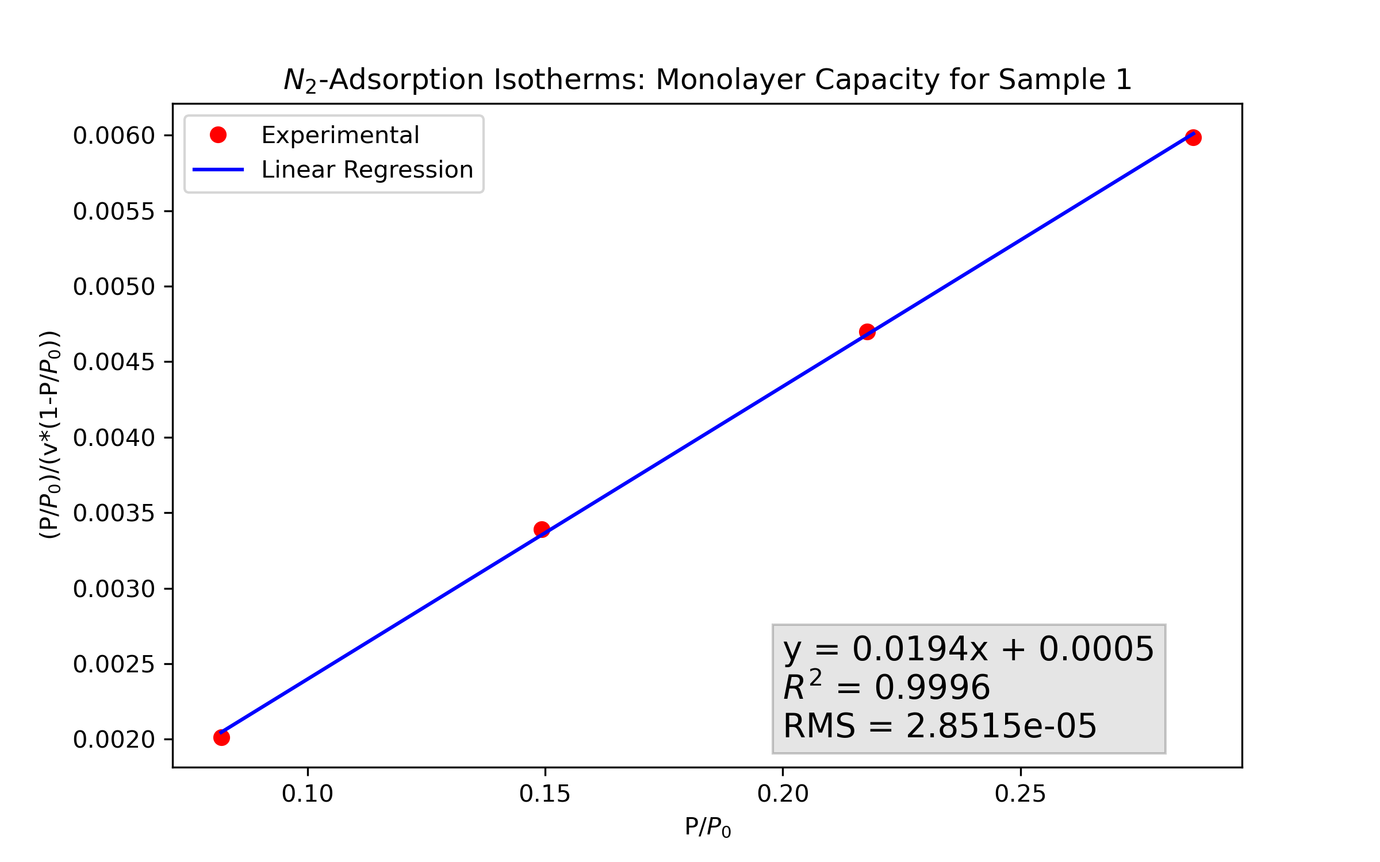
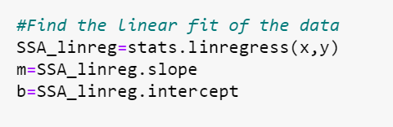
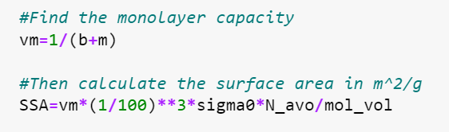

Approach: BET
Function 2: SSA
3 Inputs: P/P₀ , V, and σ₀ (=16.2e-20, optional)
Creates data in range of 0.025 to 0.3 to be used for the fit
Uses linear regression of $\frac{P/P_{0}}{v∗(1−P/P_{0})}$ vs. $P/P_{0}$
Calculates monolayer capacity ($v_{m}=\frac{1}{slope+intercept}$ )
Calculates $SSA=\frac{v_{m}∗σ_{0}∗N_{avogadros}}{0.0224 m^{3}/mol}$

Slide 14
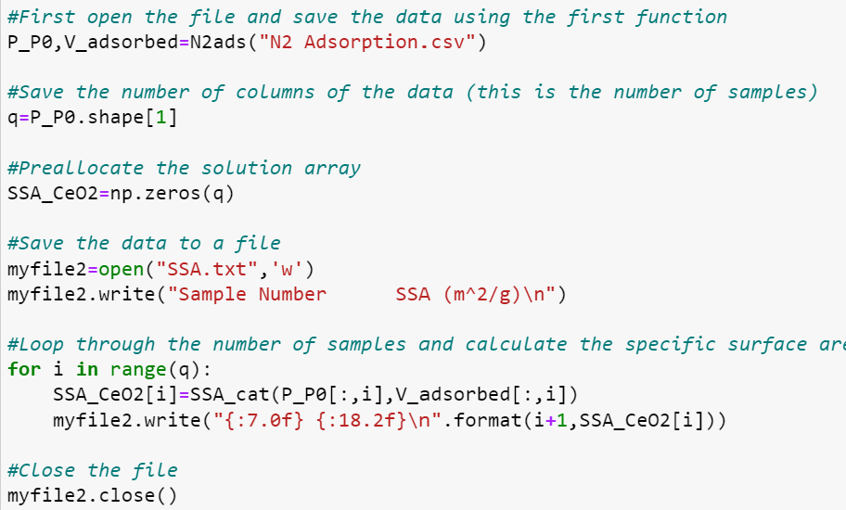
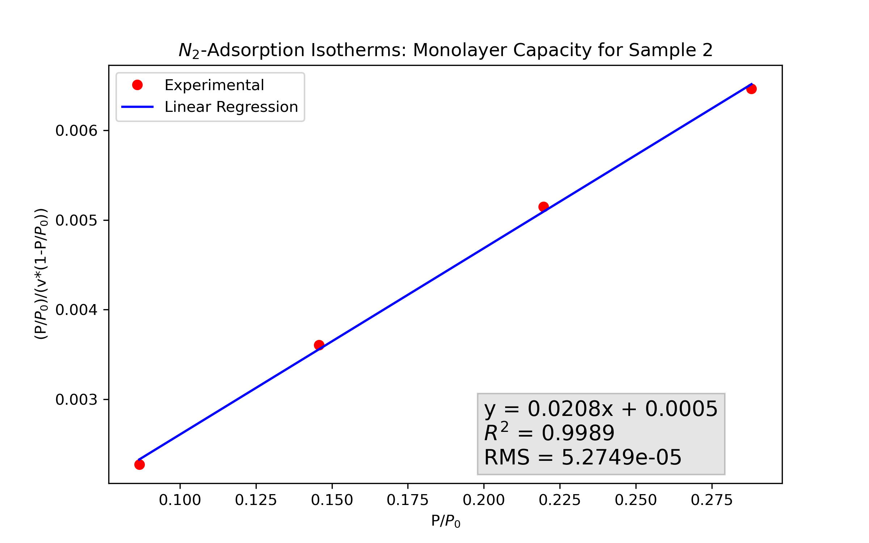
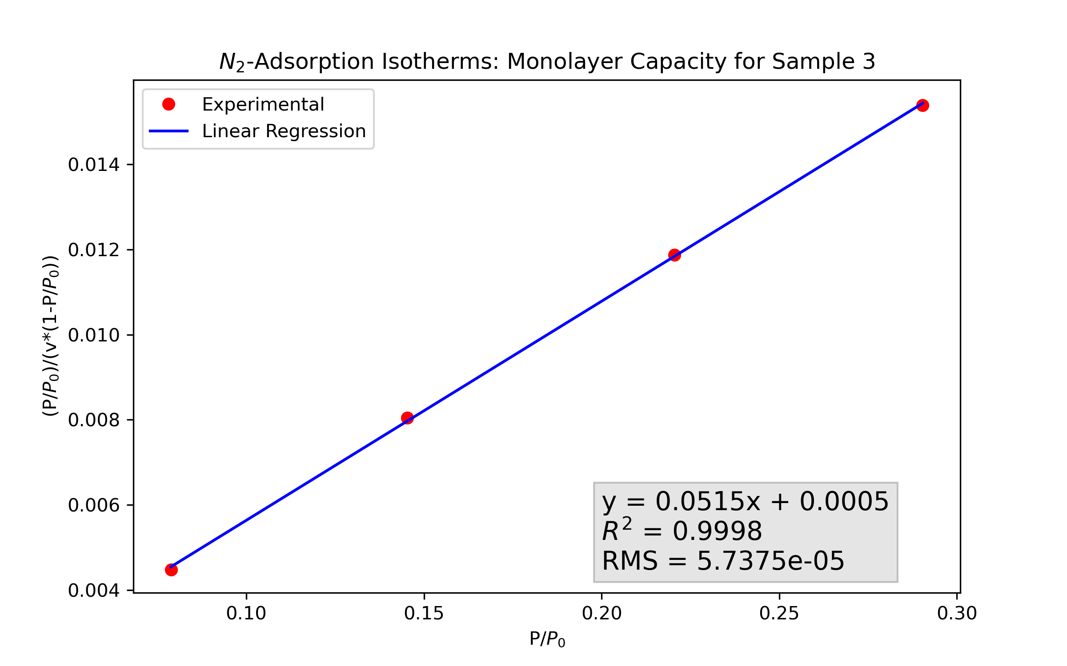
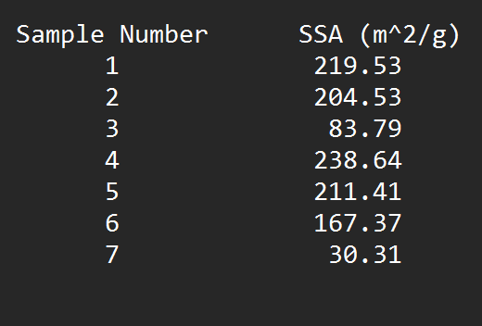
Approach: BET
Script:
Calls the first function to extract the data
Open a file to write the specific surface area results to
Loop through the number of samples and call the second function for each
Store the data in a numpy array and write to text file

Slide 15
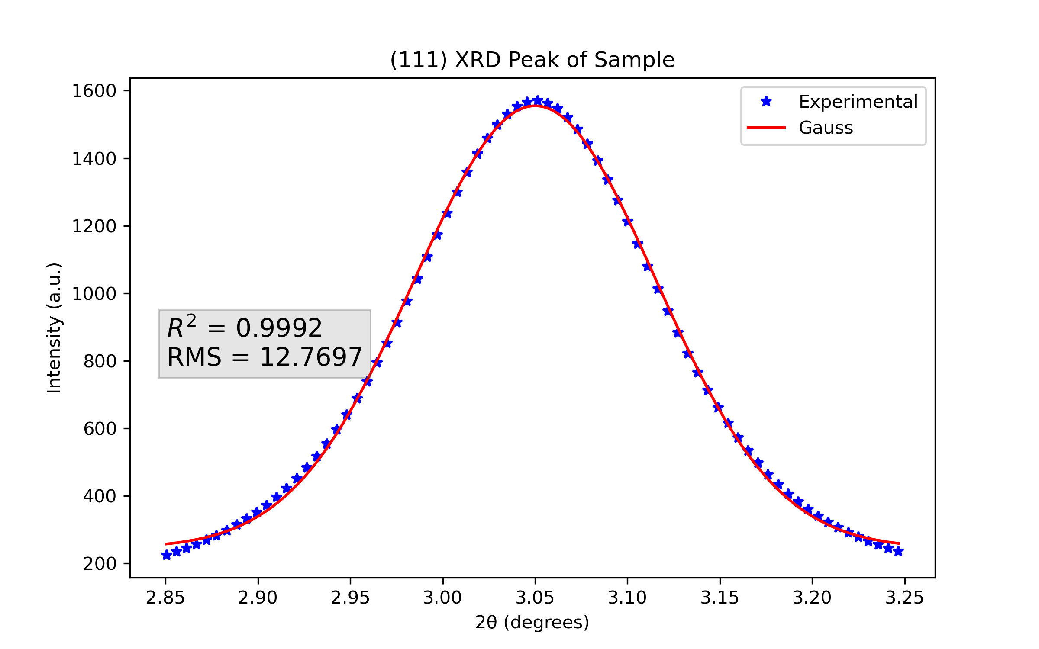
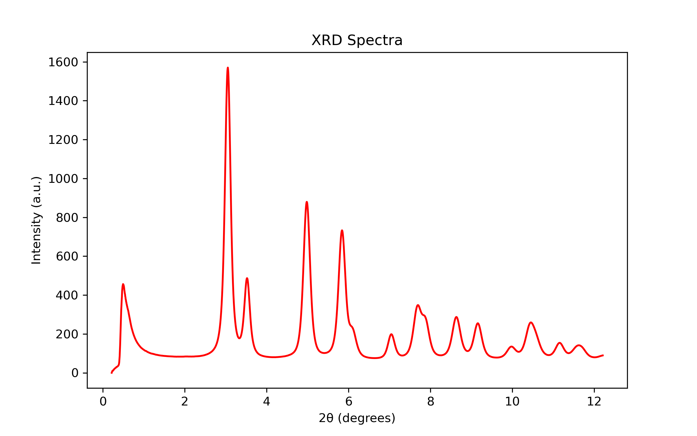
Results and Discussion: XRD
XRD plots are important for a qualitative analysis of crystallinity (sharp peaks mean more crystalline while broad peaks are more amorphous)
The R² value was very close to 1 showing that the fitting used for calculating crystallite size is reliable

Slide 16
Results and Discussion: XRD
Sample | Crystallite Size (nm)
Sample 1 (400°C Calcined) | 5.15
Sample 2 (500°C Calcined) | 4.89
Sample 3 (700°C Calcined) | 7.28
The crystallite size remained relatively close at low temperatures (400-500°C).
With increasing calcination temperature (from 500°C to 700°C), the crystallite size decreased
Shows signs of sintering in the materials→ elevated temperatures under an oxidizing atmosphere leads to agglomeration of particles and larger crystallites

Slide 17
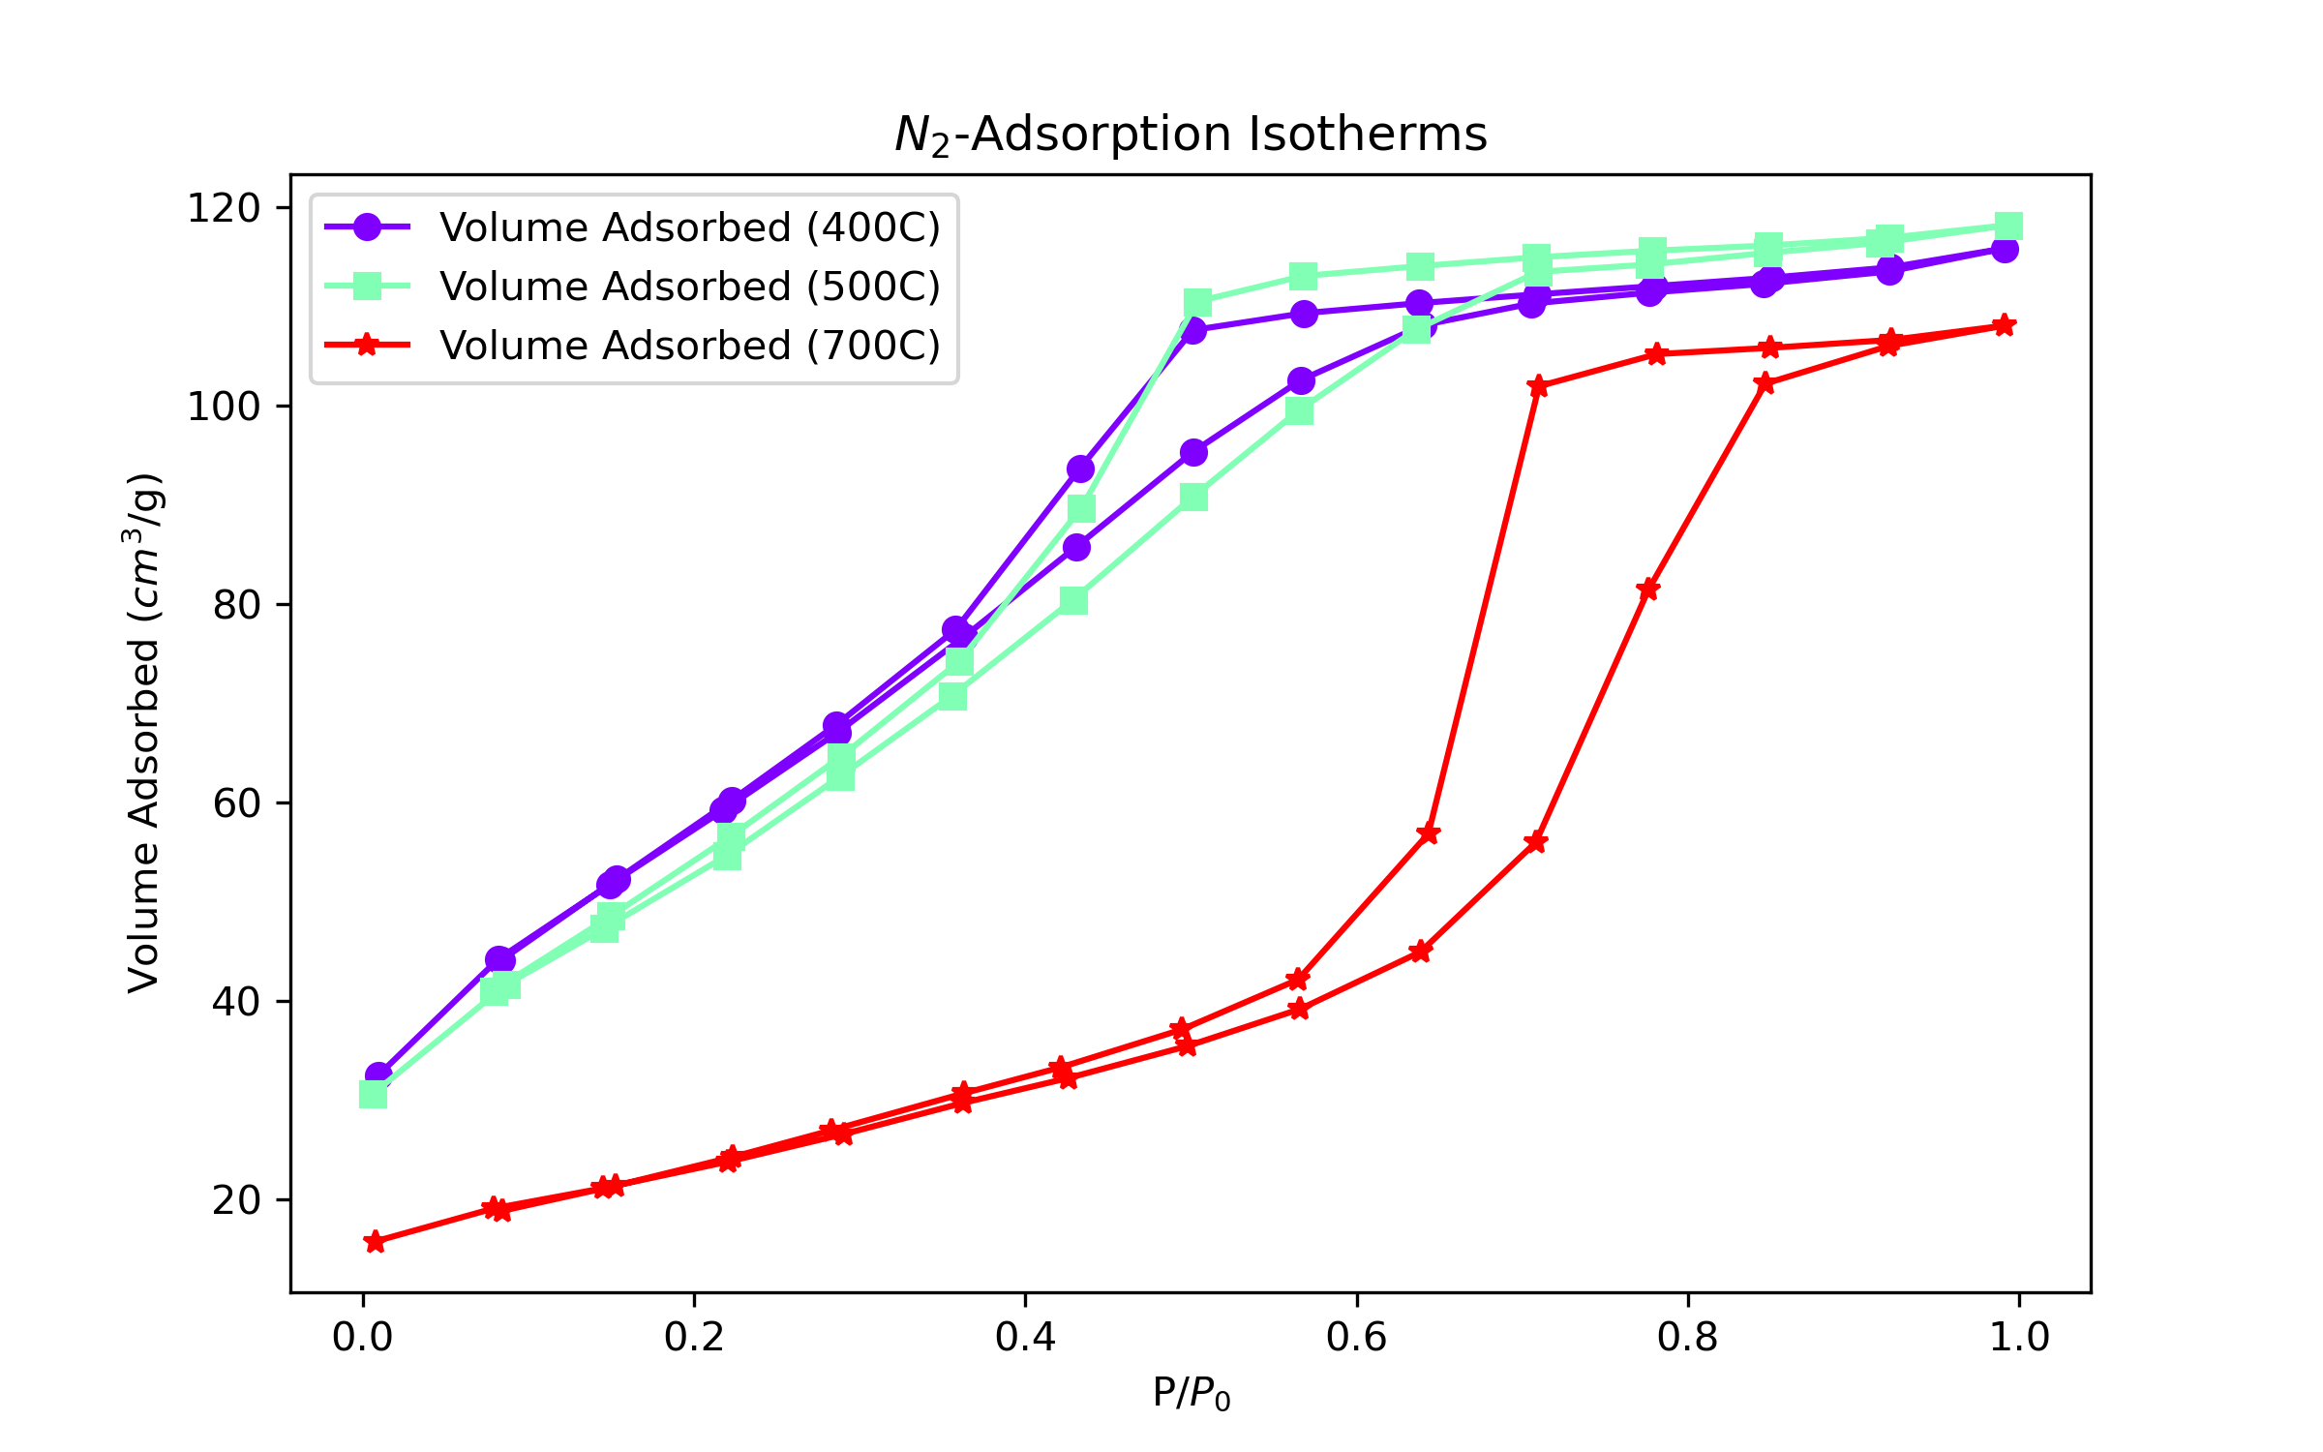
Results and Discussion: BET
Results of Function 1
400°C and 500°C sample exhibit a type IV isotherm with an H1 hysteresis loop. [12]
Mesoporous structure with well-defined cylindrical pores
700°C sample exhibits a type V isotherm with an H3 hysteresis loop. [12]
Porous structure with slit shaped pores

Slide 18
Results and Discussion: BET
Results of Function 1 and 2 and script
Sample | Specific Surface Area (m²/g)
Sample 1 (400°C Calcined) | 219.53
Sample 2 (500°C Calcined) | 204.53
Sample 3 (700°C Calcined) | 83.79
The R² value was very close to 1 showing that the monolayer capacity result is reliable
SSA decreased with increasing calcination temperature (from 500°C to 700°C)
Shows signs of sintering in the materials→ elevated temperatures under an oxidizing atmosphere leads to agglomeration of particles and less reactive surface area

Slide 19

Conclusions
Utilization of Python allows for an open-source and free method of analyzing large quantities of data.
Calculations of SSA from characterization data can be performed for multiple samples at once thus saving time.
Calculations of crystallite size can be performed using a variety of peaks and can also be used for plotting applications.
The nature of this code allows for a user to easily plug in the data file name and to have the results returned without requiring a significant understanding of Python.
Future work: Creating a user interface using prompts and XRD code working with multiple samples

Slide 20
References
[1] J.A. Rodriguez et al., Ceria-Based Model Catalysts: Fundamental Studies on the Importance of the Metal-Ceria Interface in CO Oxidation, the Water-Gas Shift, CO₂ Hydrogenation, and Methane and Alcohol Reforming, Chem. Soc. Rev. 46 (2017) 1824-1841. https://doi.org/10.1039/C6CS00863A
[2] NASA Global Climate Change, Fourteen years of carbon monoxide from MOPITT. https://climate.nasa.gov/news/2291/fourteen-years-of-carbon-monoxide-from-mopitt/, 2015.
[3] I. Langmuir, The mechanism of the catalytic action of platinum in the reactions 2CO + O₂ = 2CO₂ and 2H₂ + O₂ = 2H₂O, Transactions of the Faraday Society. 17 (1922) 621-654. https://doi.org/10.1039/TF9221700621.
[4] E. Özkan et al., Rational Synthesis Concept for Cerium Oxide Nanoparticles: On the Impact of Particle Size on the Oxygen Storage Capacity, The Journal of Physical Chemistry C. 124 (2020) 8736-8748. https://doi.org/10.1021/acs.jpcc.0c00010.
[5] E. Aneggi et al., Surface-structure sensitivity of CO Oxidation Over Polycrystalline Ceria Powders, Journal of Catalysis. 234 (2005) 88-95. https://doi:10.1016/j.jcat.2005.06.008.
[6] J. Kullgren, Oxygen Vacancy Chemistry in Ceria, Digital Comprehensive Summaries of Uppsala Dissertations from the Faculty of Science and Technology. 896 (2012) 59.
[7] A. Alshammari et al., Supported Gold Nanoparticles as Promising Catalysts, Catalystic Application of Nano-Gold Catalysts (2016). http://dx.doi.org/10.5772/64394
[8] Origin. Software Cientifico. Software Cientifico S.L. http://www.softwarecientifico.com/origin/
[9] XRD Crystallite (Grain) Size Calculator (Scherrer Equation). Instanano. Instanano. https://instanano.com/all/characterization/xrd/crystallite-size/.
[10] C.F. Holder et al., Tutorial on Powder X-ray Diffraction for Characterizing Nanoscale Materials, ACS Nano 13 (2019) 7359-7365. http://dx.doi.org/10.1021/acsnano.9b05157
[11] Particle Tech Labs, BET Specific Surface Area. https://particletechlabs.com/analytical-testing/bet-specific-surface-area/
[12] M. Thommes et al. Physisorption of gases, with special reference to the evaluation of surface area and pore size distribution, Pure Applied Chemistry. 87 (2015) 1051-1069.

